Slide 1
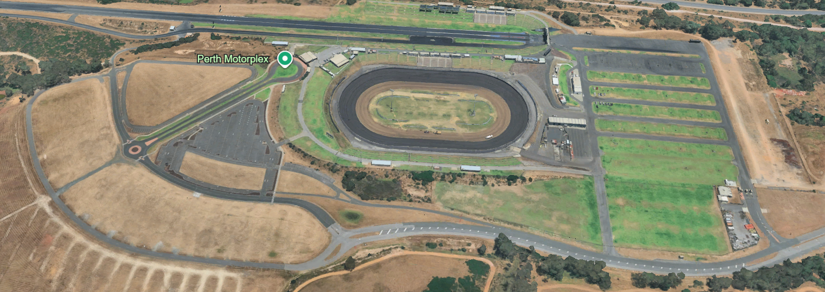
SPEED CONTROL CHICANES
PITS N PARKING
ALL ACCESS
START
FINISH

